Slide 1






Foundations of
Quantum Information Science (QIS 102)
Dave Biersach
Brookhaven National Laboratory
dbiersach@bnl.gov
Session 20
Quantum Mechanics

Slide 2
Session 20 – Part 1 of 3 – Topics
Appreciate the conundrum of the interference pattern made by a single particle passing through a double slit
Represent qubits as a vector having complex amplitudes and a canonical measurement basis set
Derive the three-dimensional Bloch Sphere representation of a qubit having a potential global phase
Assess the interplay of quantum conjugate variables
Learn the Dirac bra-ket notation for representing a basis-independent generalized inner product
Determine the probability of a system moving between two states by calculating their transition amplitude

Slide 3
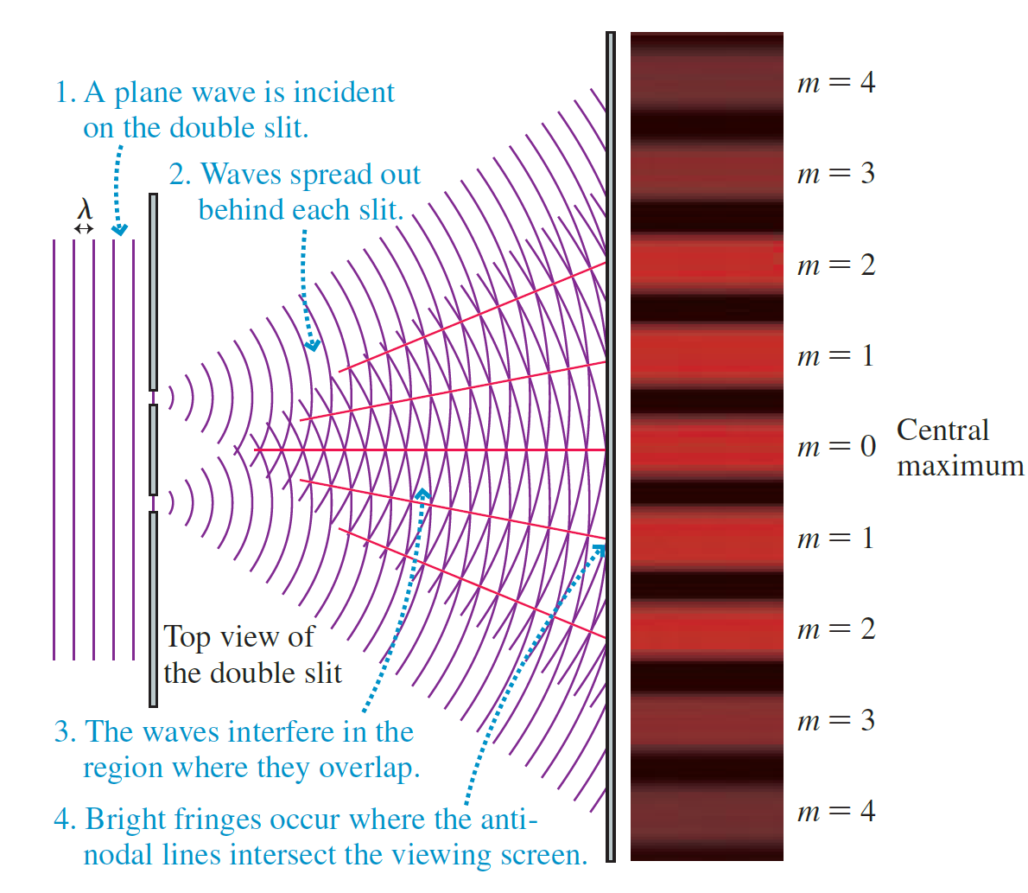
Classical Double Slit Experiment
Water Waves

Slide 4
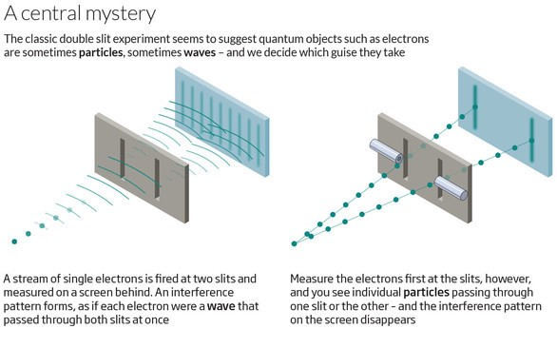
Quantum Double Slit Experiment

Slide 5
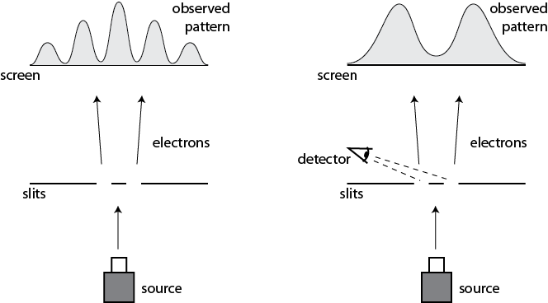
Quantum Double Slit Experiment
This happens even if we only allow a single electron at a time to pass through the slits

Slide 6
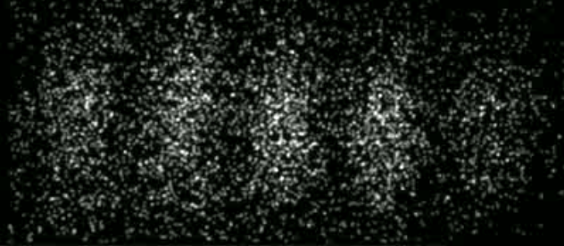
Quantum Double Slit Experiment
Time-Lapse Photograph of Single Electron Double-Slit Interference Pattern
In 1965, Richard Feynman called this the
"central mystery" of quantum theory, and then corrected himself, saying that in fact
"it is the only mystery"
Herman Batelaan, University of Nebraska-Lincoln, 2013

Slide 7
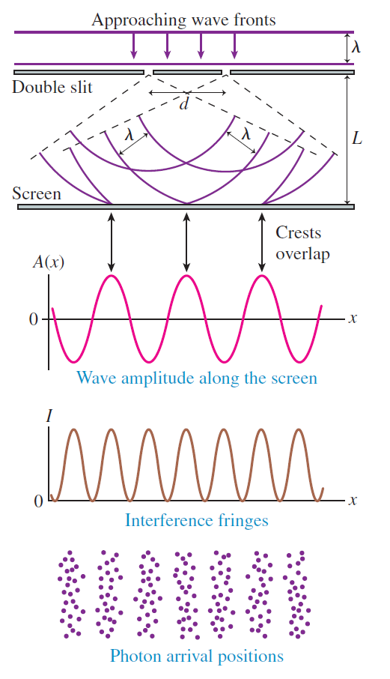
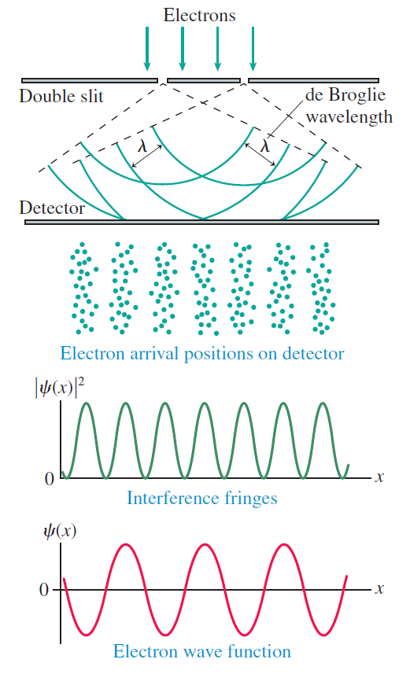
Quantum Double Slit Experiment
Photons

Slide 8
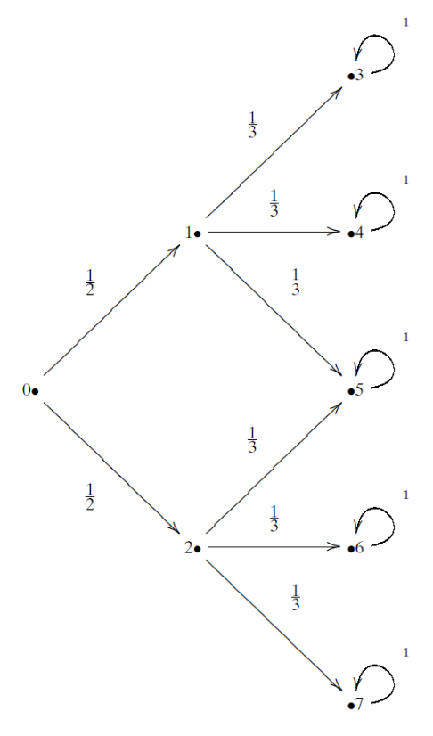
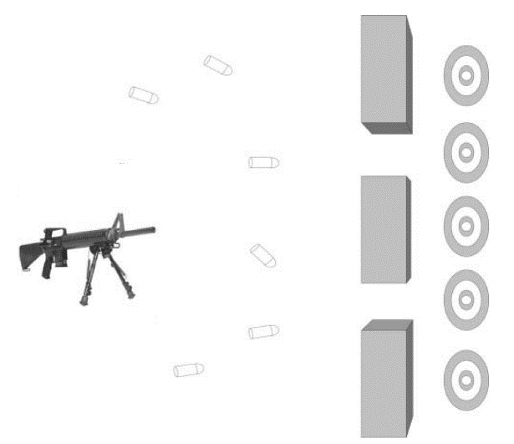
The Double Slit Experiment as a Matrix
Bullets
(Particles)
Transition Probability

Slide 9
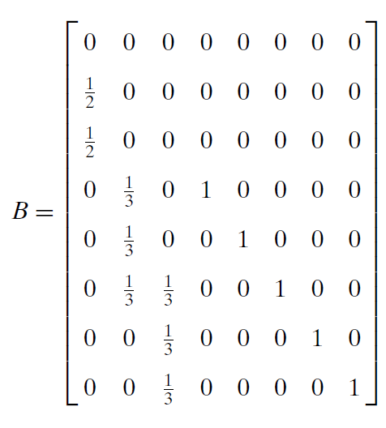
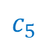


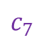
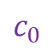
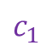
The Double Slit Experiment as a Matrix
FROM
$$c_{0}$$
$$c_{1}$$
$$c_{7}$$
$$c_{0}$$
TO
$$c_{5}$$
$$c_{7}$$
Bullet
Transition Probabilities For One Time Step

Slide 10
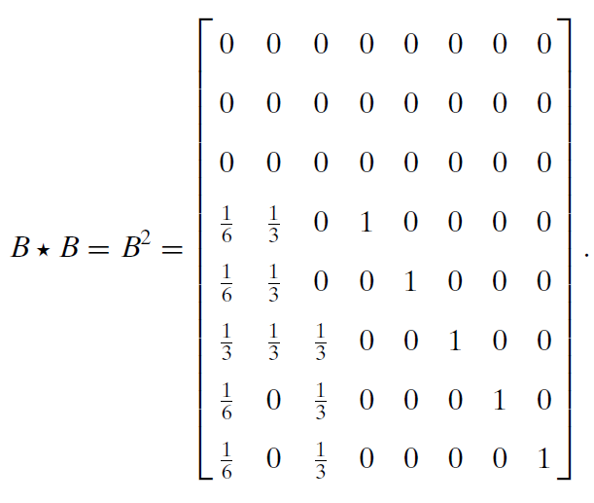
The Double Slit Experiment as a Matrix
Every time we multiple a transition matrix by itself,
we can calculate another time step (the next transition matrix)
Bullet
Transition Probabilities For
One Time Step
Bullet
Transition Probabilities After
Two Time Steps

Slide 11
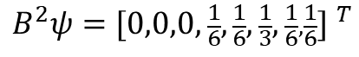
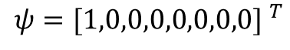
The Double Slit Experiment as a Matrix
Bullet Location Probabilities After Two Time Steps
$$ψ={[1,0,0,0,0,0,0,0] }^{T}$$
$$B^{2}ψ={[0,0,0,\frac{1}{6},\frac{1}{6},\frac{1}{3},\frac{1}{6},\frac{1}{6}] }^{T}$$

Slide 12
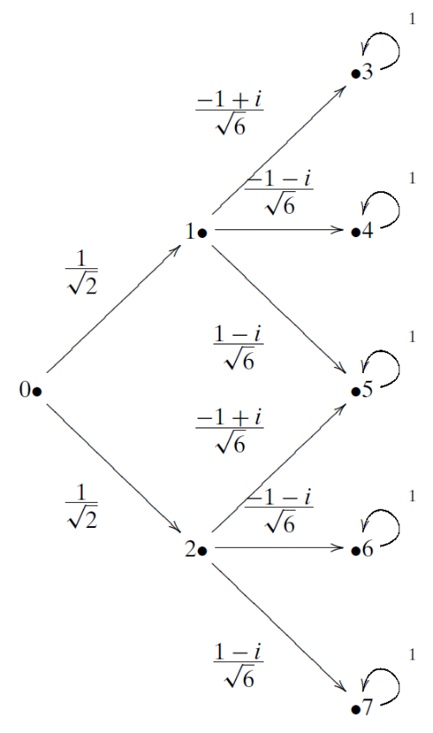
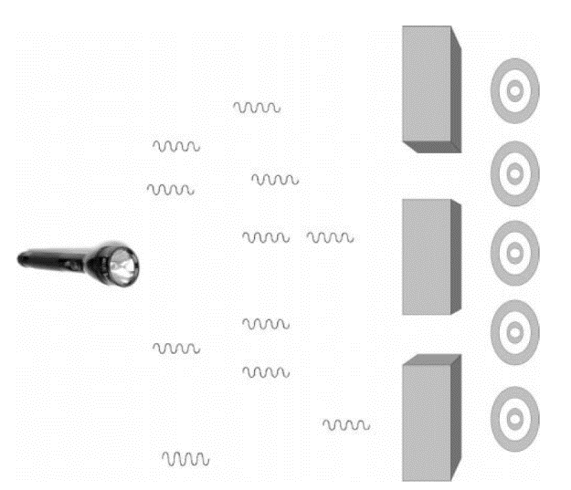
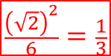
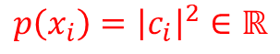
The Quantum Double Slit as a Matrix
Transition Amplitude
Photons
$$\frac{{\left(\sqrt{2}\right)}^{2}}{6}=\frac{1}{3}$$
$$\frac{1}{2}$$
When we square the norm of a transition amplitude, we get the transition probability
$$p\left(x_{i}\right)={\left|c_{i}\right|}^{2}∈ℝ$$

Slide 13
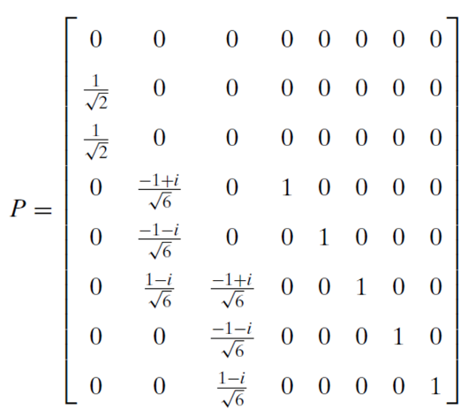
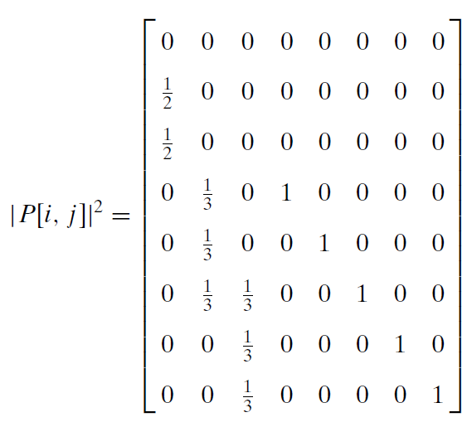
The Quantum Double Slit as a Matrix
When we measure a photon, its wave function collapses, and the norm squared of each amplitude becomes a probability
Photon
Transition Amplitudes For
One Time Step
Photon
Transition Probabilities For
One Time Step

Slide 14

The Quantum Double Slit as a Matrix
Once we measure the photon,
it acts like a bullet (a particle)…
$$=$$
Photon
Transition Probabilities For
One Time Step
Bullet
Transition Probabilities For
One Time Step

Slide 15
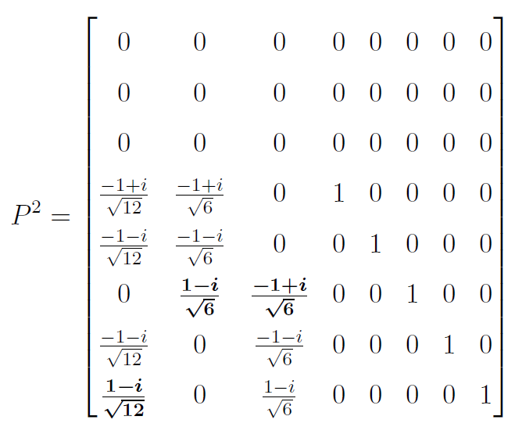

The Quantum Double Slit as a Matrix
If we do not measure the photon, we continue to use its transition amplitudes to calculate the next step…
$$P∙P$$
Photon
Transition Amplitudes For
One Time Step
Photon
Transition Amplitudes For
Two Time Steps

Slide 16
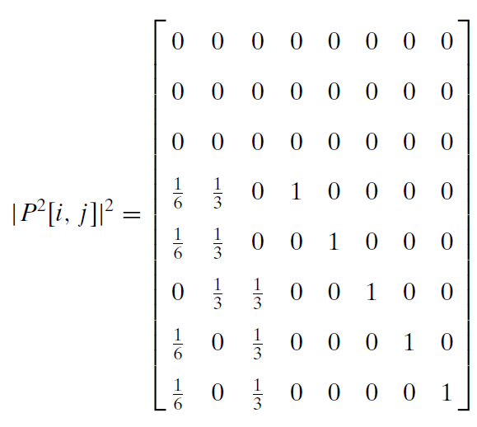
The Quantum Double Slit as a Matrix
If we measure the photon after the first step:
If we measure the photon only after the second step:
Photon
Transition Probabilities For
One Time Step
Photon
Transition Probabilities For
Two Time Steps

Slide 17

The Quantum Double Slit as a Matrix
If we wait to measure the photon only after two steps, we see it is acting like a wave (not like a particle)…
$$≠$$
Bullet
Transition Probabilities For
Two Time Steps
Photon
Transition Probabilities For
Two Time Steps

Slide 18
The Quantum Double Slit as a Matrix
Photons
Photon
Transition Probabilities For
Two Time Steps
The complex amplitudes in the photon's operator cause destructive interference

Slide 19
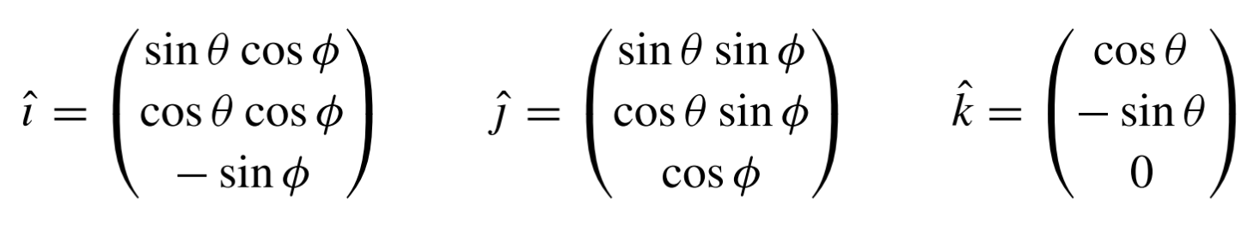
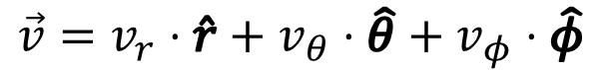
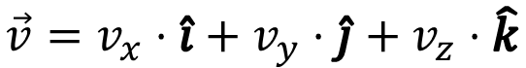
Basis Vectors
$$\vec{v}=\left(\begin{matrix}v_{x} \\ v_{y} \\ v_{z}\end{matrix}\right)$$
A vector exists independently of its basis – but its components do not
$$\vec{v}=v_{x}⋅\hat{i}+v_{y}⋅\hat{j}+v_{z}⋅\hat{k}$$
$$\vec{v}=v_{r}⋅\hat{r}+v_{θ}⋅\hat{θ}+v_{φ}⋅\hat{φ}$$
Cartesian Basis Vectors in Spherical Coordinates
You cannot specify just the components of a vector unless it is clear what basis you are using

Slide 20
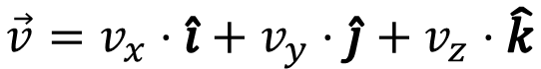
Ket Notation
A ket symbol represents a vector
$$\vec{v}=v_{x}⋅\hat{i}+v_{y}⋅\hat{j}+v_{z}⋅\hat{k}$$
$$\left|\left.v\right\rangle \right.=v_{x}\left|\left.\hat{i}\right\rangle \right.+v_{y}\left|\left.\hat{j}\right\rangle \right.+v_{z}\left|\left.\hat{k}\right\rangle \right.$$
Remember, components can be complex scalars
$$\left|\left.v\right\rangle \right.=c_{0}\left|\left.ϵ_{0}\right\rangle \right.+c_{1}\left|\left.ϵ_{1}\right\rangle \right.+c_{2}\left|\left.ϵ_{2}\right\rangle \right.$$
In higher dimensions, we do not use $i, j, k$ Instead we use generalized basis kets $\left.\left|ε_{n}\right.\right\rangle$
and number the component subscripts
instead of using $x, y, z$

Slide 21

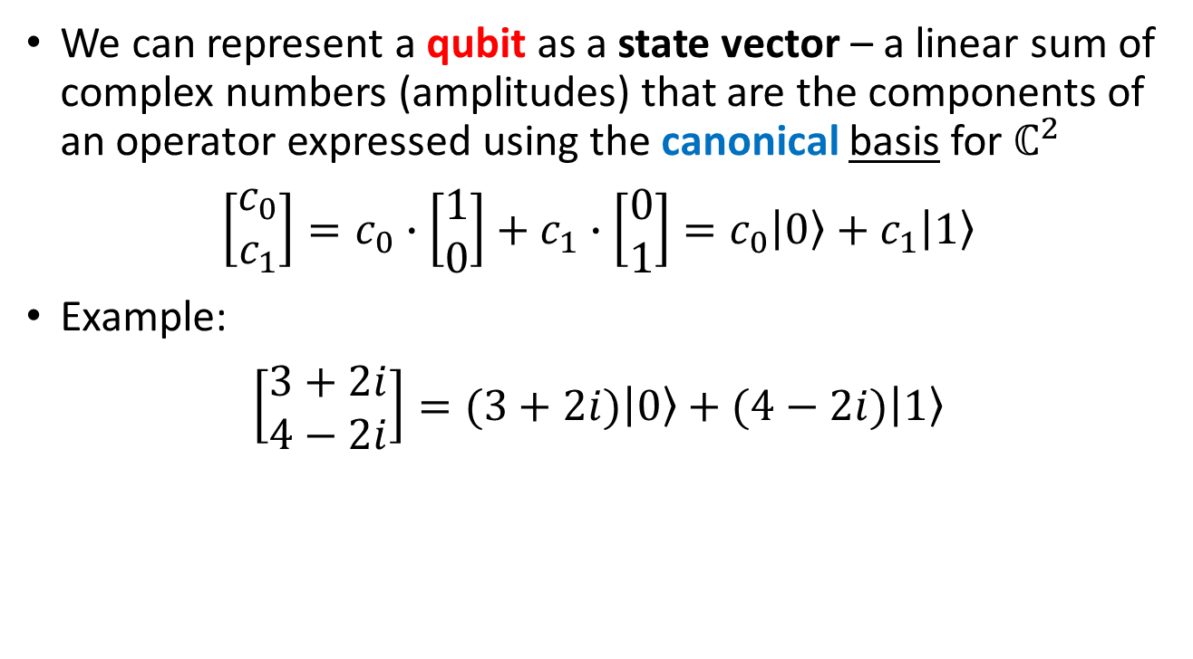
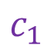
Representing a Qubit
We can represent a qubit as a state vector – a linear sum of complex numbers (amplitudes) that are the components of an operator expressed using the canonical basis for $ℂ^{2}$
$$\left[\begin{matrix}c_{0} \\ c_{1}\end{matrix}\right]=c_{0}∙\left[\begin{matrix}1 \\ 0\end{matrix}\right]+c_{1}∙\left[\begin{matrix}0 \\ 1\end{matrix}\right]=c_{0}\left.\left|0\right.\right\rangle +c_{1}\left.\left|1\right.\right\rangle$$
Example:
$$\left[\begin{matrix}3+2i \\ 4−2i\end{matrix}\right]=(3+2i)\left.\left|0\right.\right\rangle +(4−2i)\left.\left|1\right.\right\rangle$$
$$c_{0}$$
$$c_{1}$$

Slide 22
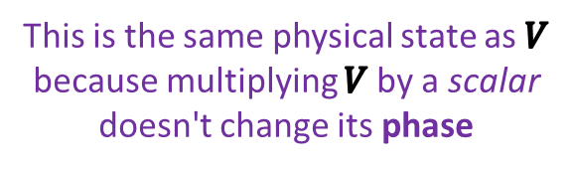
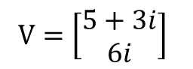
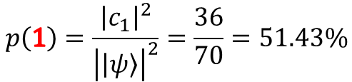
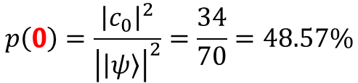
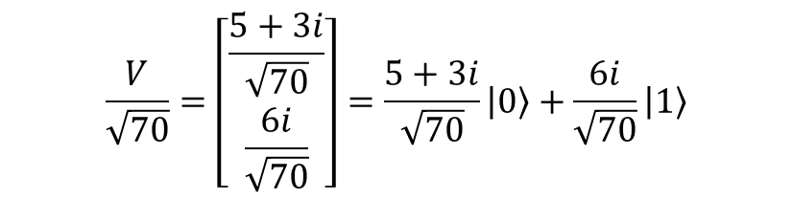
Representing a Qubit
$V=\left[\begin{matrix}5+3i \\ 6i\end{matrix}\right]$
What is the probability we will measure this qubit with a specific classical value of 0 or 1 ?
$$\left|V\right|=\sqrt{\left\langle V | V\right\rangle }=\sqrt{\left[\begin{matrix}5−3i & −6i\end{matrix}\right]\left[\begin{matrix}5+3i \\ 6i\end{matrix}\right]}=\sqrt{34+36}=\sqrt{70}$$
1x2
2x1
1x1
$$\frac{V}{\sqrt{70}}=\left[\begin{matrix}\frac{5+3i}{\sqrt{70}} \\ \frac{6i}{\sqrt{70}}\end{matrix}\right]=\frac{5+3i}{\sqrt{70}}\left.\left|0\right.\right\rangle +\frac{6i}{\sqrt{70}}\left.\left|1\right.\right\rangle$$
Normalize the state vector
This is the same physical state as $V$ because multiplying $V$by a scalar doesn't change its phase
$$p\left(0\right)=\frac{{\left|c_{0}\right|}^{2}}{{\left|\left|\left.ψ\right\rangle \right.\right|}^{2}}=\frac{34}{70}=48.57\%$$
$$p\left(1\right)=\frac{{\left|c_{1}\right|}^{2}}{{\left|\left|\left.ψ\right\rangle \right.\right|}^{2}}=\frac{36}{70}=51.43\%$$

Slide 23
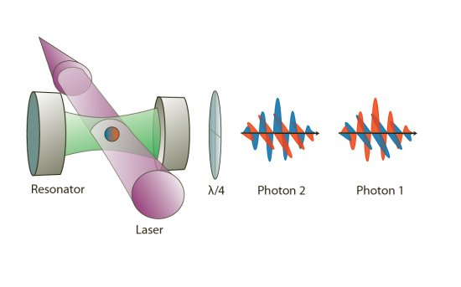
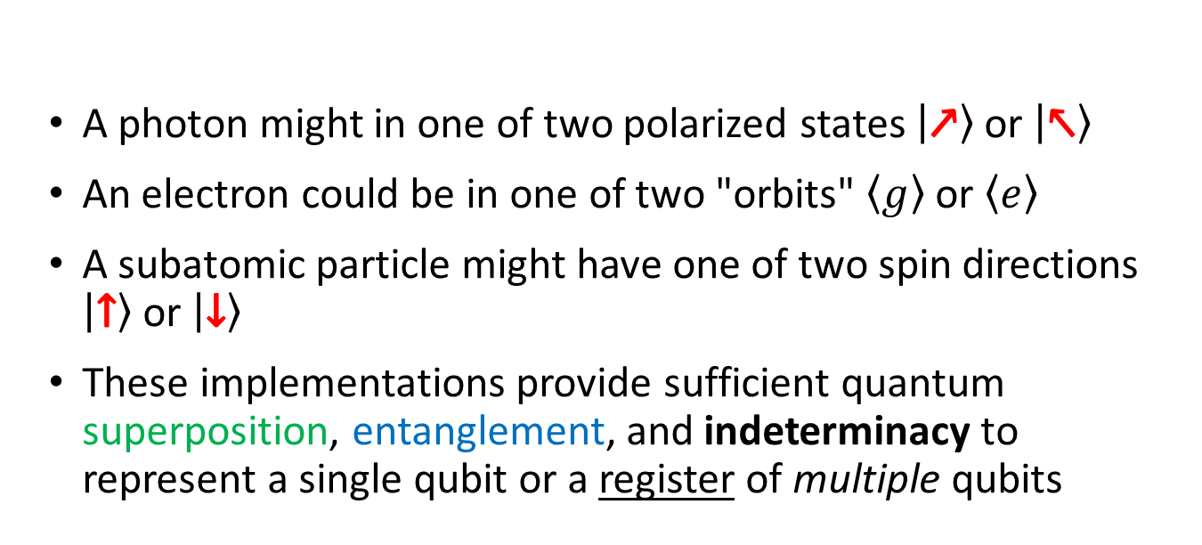
How are Qubits Implemented?
A photon might in one of two polarized states $\left.\left|↗\right.\right\rangle$ or $\left.\left|↖\right.\right\rangle$
An electron could be in one of two "orbits" $\left\langle g\right\rangle$ or $\left\langle e\right\rangle$
A subatomic particle might have one of two spin directions $\left.\left|↑\right.\right\rangle$ or $\left.\left|↓\right.\right\rangle$
These implementations provide sufficient quantum superposition, entanglement, and indeterminacy to represent a single qubit or a register of multiple qubits

Slide 24
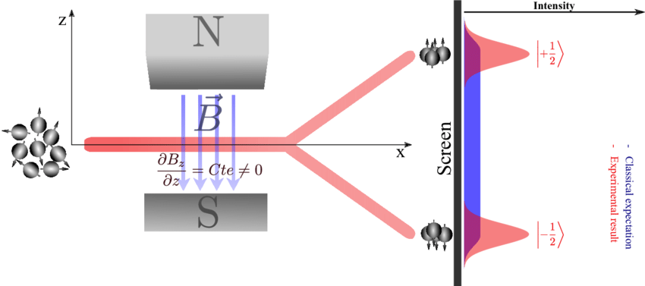
A True Quantum Basis
Stern-Gerlach Experiment (1922)
When measured, the electron has only two possible (distinct) spin states
Spin (up or down) is the basis in this $ψ$
$$\left.\left|ψ\right.\right\rangle =c_{0}\left.\left|↑\right.\right\rangle +c_{1}\left.\left|↓\right.\right\rangle$$

Slide 25
The Bloch Sphere
How can we visually represent a qubit on a printed page using only black & white ink?
$$\left.\left|ψ\right.\right\rangle =(a+bi)\left.\left|0\right.\right\rangle +(c+di)\left.\left|1\right.\right\rangle$$
It appears we must be able to plot four independent parameters: $\left(a,b,c,d\right)∈ℝ$
Therefore, we have a 4D object to visualize,
but we only have a 2D plane upon which we can draw
We cannot use the trick of indicating the 4th dimensional parameter using color in an oblique projection of a 3D surface

Slide 26
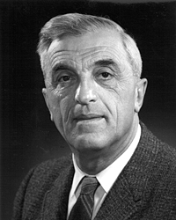
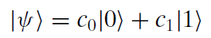
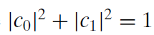
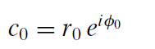
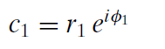
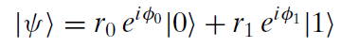
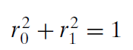
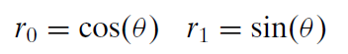
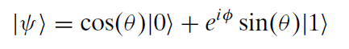



The Bloch Sphere
A complex number with a unit modulus is a point on a unit circle
A normalized ket
Euler's Formula
Felix Bloch
(1905-1983)
Substitution
Multiply ket by scalar
Killing the phase of $\left.\left|0\right.\right\rangle$
1
$$φ_{0}=0→\left|e^{iφ_{0}}\right|=1$$
$$φ=φ_{1}−φ_{0}$$
Trig version of Pythagorean Theorem
Now only two real parameters remain: $θ$ and $φ$

Slide 27
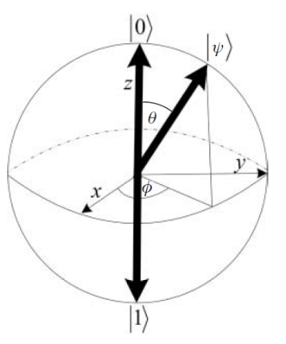
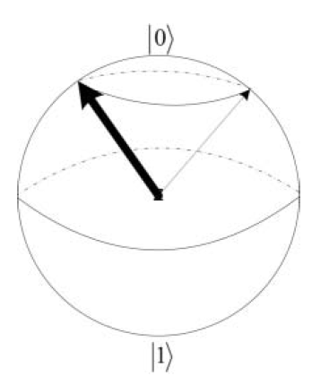
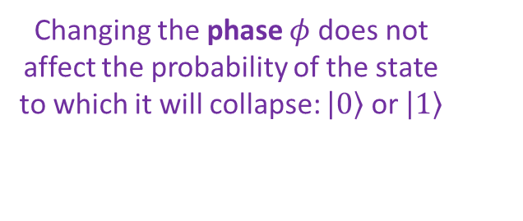


The Bloch Sphere
$$φ=φ_{1}−φ_{0}$$
Only $θ$ affects the probability $Ψ$ will collapse to either $\left|\left.0\right\rangle \right.$ or $\left|\left.1\right\rangle \right.$
$φ$ represents the qubit phase which we cannot measure
A qubit pointing anywhere around the equator has a 50/50 chance of collapsing to either $\left.\left|0\right.\right\rangle$ or $\left.\left|1\right.\right\rangle$
Changing the phase $φ$ does not affect the probability of the state to which it will collapse: $\left.\left|0\right.\right\rangle$ or $\left.\left|1\right.\right\rangle$
Every unitary 2x2 operator (a quantum gate) will "rotate" this sphere in some way

Slide 28










The Bloch Sphere
$\left|\left.ψ\right\rangle \right.$ $=\cos\left(θ\right)\left|\left.0\right\rangle \right.+e^{iφ}\sin\left(θ\right)\left|\left.1\right\rangle \right.$
Every latitude must have a singular $θ$ value
poloidal
$$0≤θ≤2π$$
toroidal
$$0≤φ≤2π$$
$$\left|\left.ψ\right\rangle \right.=\left[\begin{matrix}α \\ β\end{matrix}\right]=α\left|\left.0\right\rangle \right.+β\left|\left.1\right\rangle \right.$$
$$α=\cos\left(\frac{θ}{2}\right)$$
$$β=e^{iφ}\sin\left(\frac{θ}{2}\right)$$
$$P\left(α\right)={\left|α\right|}^{2}={\left(\cos{\frac{θ}{2}}\right)}^{2}$$
The angle $φ$ does not affect the probabilities
$$P\left(β\right)={\left|β\right|}^{2}={\left(\sin{\frac{θ}{2}}\right)}^{2}$$

Slide 29

The Bloch Sphere

Slide 30















The Bloch Sphere
The
z basis
$\left|\left.ψ\right\rangle \right.$ $=\cos\left(θ\right)\left|\left.0\right\rangle \right.+e^{iφ}\sin\left(θ\right)\left|\left.1\right\rangle \right.$
$$0≤θ≤2π$$
$$\left|\left.ψ\right\rangle \right.=\left[\begin{matrix}α \\ β\end{matrix}\right]=α\left|\left.0\right\rangle \right.+β\left|\left.1\right\rangle \right.$$
$$0≤φ≤2π$$
Note: Probabilities require measurements, and we can't measure global phase $∴$ $φ=0$
$$α=\cos\left(\frac{θ}{2}\right)$$
$$β=\sin\left(\frac{θ}{2}\right)$$
$$θ=0$$
$$P\left(0\right)={\left(\cos{\frac{0}{2}}\right)}^{2}\left|\left.0\right\rangle \right.+{\left(\sin{\frac{0}{2}}\right)}^{2}\left|\left.1\right\rangle \right.={\left[\begin{matrix}1 & 0\end{matrix}\right]}^{T}$$
$\left|\text{0}⟩\right.$ in the z basis
$$θ=π$$
$$P\left(π\right)={\left(\cos{\frac{π}{2}}\right)}^{2}\left|\left.0\right\rangle \right.+{\left(\sin{\frac{π}{2}}\right)}^{2}\left|\left.1\right\rangle \right.={\left[\begin{matrix}0 & 1\end{matrix}\right]}^{T}$$
$\left|\text{1}⟩\right.$ in the z basis
$$θ=π/2$$
$$P\left(\frac{π}{2}\right)={\left(\cos{\frac{π}{4}}\right)}^{2}\left|\left.0\right\rangle \right.+{\left(\sin{\frac{π}{4}}\right)}^{2}\left|\left.1\right\rangle \right.={\left[\begin{matrix}\frac{1}{2} & \frac{1}{2}\end{matrix}\right]}^{T}$$
50/50 superposition

Slide 31

Quantum Conjugate Variables

Slide 32

Open Cell 1 – wave_packet.ipynb
①
②
③
④
⑤
⑥
⑦
⑧
⑨
⑩

Slide 33

View Cell 1 – wave_packet.ipynb
①
②
③
④
⑤
⑥
⑦
⑧
⑨
⑩

Slide 34

View Cell 1 – wave_packet.ipynb
②
③
④
⑤
⑥
⑦
⑧
⑨
⑩
①

Slide 35


Run Cell 1 - wave_packet.ipynb
No uncertainty in the frequency – it is only one value…
… but the particle might be found in several different locations

Slide 36


Run Cell 2 - wave_packet.ipynb

Slide 37

Run Cell 3 - wave_packet.ipynb

Slide 38




Run Cell 4 - wave_packet.ipynb
… but now there are more frequencies the particle might have
$$p=\frac{h}{λ}$$
We are narrowing where the particle might be found…

Slide 39

Complex Amplitudes
Discretized space (locations)
These are the unique locations in this system where a particle could be found
$$\left|\left.x_{0}\right\rangle ⟼{\left[\begin{matrix}1 & 0 & 0 & ⋯ & 0\end{matrix}\right]}^{T}\right.$$
Therefore, we can use these vectors as a basis set for this system
$$\left|\left.x_{1}\right\rangle ⟼{\left[\begin{matrix}0 & 1 & 0 & ⋯ & 0\end{matrix}\right]}^{T}\right.$$
$$\left|\left.x_{i}\right\rangle ⟼{\left[\begin{matrix}0 & 0 & 1 & ⋯ & 0\end{matrix}\right]}^{T}\right.$$
$\left|\left.ψ\right\rangle \right.$ = a
"state" vector
$$\left|\left.ψ\right\rangle \right.=c_{0}\left|\left.x_{0}\right\rangle \right.+c_{1}\left|\left.x_{1}\right\rangle \right.+c_{i}\left|\left.x_{i}\right\rangle \right.+⋯+c_{n−1}\left|\left.x_{n−1}\right\rangle \right.$$
$$c_{0},c_{1},c_{i},⋯c_{n−1}$$
Complex Amplitudes
$$\left|\left.ψ\right\rangle ⟼\right.{\left[\begin{matrix}c_{0} & c_{1} & c_{i} & ⋯ & c_{n−1}\end{matrix}\right]}^{T}$$
Assuming the basis above

Slide 40

Complex Amplitudes
Discretized space (locations)
These are the unique locations in this system where a particle could be found
$$\left|\left.x_{0}\right\rangle ⟼{\left[\begin{matrix}1 & 0 & 0 & ⋯ & 0\end{matrix}\right]}^{T}\right.$$
Therefore, we can use these vectors as a basis set for this system
$$\left|\left.x_{1}\right\rangle ⟼{\left[\begin{matrix}0 & 1 & 0 & ⋯ & 0\end{matrix}\right]}^{T}\right.$$
$$\left|\left.x_{i}\right\rangle ⟼{\left[\begin{matrix}0 & 0 & 1 & ⋯ & 0\end{matrix}\right]}^{T}\right.$$
A superposition of all possible allowed locations
$$\left|\left.ψ\right\rangle =c_{0}\left|\left.x_{0}\right\rangle \right.+c_{1}\left|\left.x_{1}\right\rangle \right.+c_{i}\left|\left.x_{i}\right\rangle \right.+⋯+c_{n−1}\left|\left.x_{n−1}\right\rangle \right. \right.$$
$$\left|\left.ψ\right\rangle ⟼\right.{\left[\begin{matrix}c_{0} & c_{1} & c_{i} & ⋯ & c_{n−1}\end{matrix}\right]}^{T}$$
The probability of detecting the particle at location $x_{i}$
$$p\left(x_{i}\right)=\frac{{\left|c_{i}\right|}^{2}}{{\left|\left|\left.ψ\right\rangle \right.\right|}^{2}}$$
Upon measurement, the particle has a distinct location
(it "collapses")
$\left|\left.ψ\right\rangle \right.⟶$ $x_{i}$

Slide 41





Complex Amplitudes
Discretized space (locations)
Orthonormal basis
$$x_{0}$$
$$x_{1}$$
$$x_{2}$$
$$x_{3}$$
Assume a particle could be in only one of four points
$$\left\{x_{0},x_{1},x_{2},x_{3}\right\}$$
$\left.\left|ψ\right.\right\rangle$ in this basis
$$\left.\left|ψ\right.\right\rangle =\left[\begin{matrix}−3−i \\ −2i \\ i \\ 2\end{matrix}\right]$$
$$\begin{matrix}0 \\ 1 \\ 2 \\ 3\end{matrix}$$
Given these probability amplitudes
$$c_{2}=i$$
What is the probability of finding it at location $x_{2}$ ?
$$p\left(x_{i}\right)=\frac{{\left|c_{i}\right|}^{2}}{{\left|\left|\left.ψ\right\rangle \right.\right|}^{2}}$$
$$p\left(x_{2}\right)=\frac{{\left|c_{2}\right|}^{2}}{{\left|\left|\left.ψ\right\rangle \right.\right|}^{2}}$$

Slide 42












Complex Amplitudes
Discretized space (locations)
$$\left\{x_{0},x_{1},x_{2},x_{3}\right\}$$
$$x_{0}$$
$$x_{1}$$
$$x_{2}$$
$$x_{3}$$
$$\left.\left|ψ\right.\right\rangle =\left[\begin{matrix}−3−i \\ −2i \\ i \\ 2\end{matrix}\right]$$
$$\begin{matrix}0 \\ 1 \\ 2 \\ 3\end{matrix}$$
$$p\left(x_{2}\right)=\frac{{\left|c_{2}\right|}^{2}}{{\left|\left|\left.ψ\right\rangle \right.\right|}^{2}}$$
$$c_{2}=i$$
$${\left|c\right|}^{2}=\left\langle c | c\right\rangle$$
$$=c^{†}⋅c$$
What is the probability of finding it at location $x_{2}$ ?
$${\left|c_{2}\right|}^{2}=\left(0−i\right)\left(0+i\right)=1$$
$$\left|\left.\left|ψ\right.\right\rangle \right|=\sqrt{{\left|c_{0}\right|}^{2}+{\left|c_{1}\right|}^{2}{+\left|c_{2}\right|}^{2}+{\left|c_{3}\right|}^{2}}$$
$$p\left(x_{2}\right)=\frac{{\left|c_{2}\right|}^{2}}{{\left|\left|\left.ψ\right\rangle \right.\right|}^{2}}$$
$$=\sqrt{10+4+1+4}$$
$$p\left(x_{2}\right)=\frac{1}{19}=.052624≈5\%$$
$$=\sqrt{19}$$

Slide 43

Complex Amplitudes
$\left.\left|ψ\right.\right\rangle$ is a ket : the right-hand side of a "bra-ket"
Because scalar multiplication of a $\left.\left|ψ\right.\right\rangle$ does not change its probabilities…
$$\left.\left(s\right)\left|ψ\right.\right\rangle ⟼p\left(x_{i}\right)$$
Paul Dirac
(1902-1984)
$$\frac{1}{\left|\left.\left|ψ\right.\right\rangle \right|}\left.\left|ψ\right.\right\rangle ⟼p\left(x_{i}\right)$$
…we can divide a $\left.\left|ψ\right.\right\rangle$by its norm and not affect its outcomes
$$\frac{\left.\left|ψ\right.\right\rangle }{\left|\left.\left|ψ\right.\right\rangle \right|}$$
Normalizing a state vector will not affect the outcomes but ensures the sum of all probabilities = 1.0
A normalized ket
Outcome probability in a normalized ket is the amplitude squared
$$p\left(x_{i}\right)={\left|c_{i}\right|}^{2}$$
The Born Rule

Slide 44





Dirac "Bra-Ket" Notation
Bra
Ket
$$\left\langle ψ | ψ\right\rangle ∈ℝ$$
$$\left\langle v1 | v2\right\rangle ∈ℂ$$
if $v_{1}≠v_{2}$
The solutions to the Schrodinger equation are functions of space and time called quantum wavefunctions, which are the projections of quantum states onto a specified basis system

Slide 45

Transition Amplitudes
Start State
End State
$$\left.\left|ψ\right.\right\rangle =\left[\begin{matrix}c_{0} \\ c_{1} \\ ⋮ \\ c_{n−1}\end{matrix}\right]$$
$$\left.\left|ψ^{′}\right.\right\rangle =\left[\begin{matrix}c_{0}^{′} \\ c_{1}^{′} \\ ⋮ \\ c_{n−1}^{′}\end{matrix}\right]$$
What is the transition amplitude of moving from initial state $\left.\left|ψ\right.\right\rangle$ to end state $\left.\left|ψ^{′}\right.\right\rangle$ ?
$$\left\langle \left.ψ^{′}\right|\right.={\left.\left|ψ^{′}\right.\right\rangle }^{†}$$
This is a Dirac bra : the left-hand side of a "bra(c)ket" and is another vector (the Hermitian of its ket)
Note: $\left.\left|ψ\right.\right\rangle$ is a different ket than $\left.\left|ψ^{′}\right.\right\rangle$ $∴$ $ψ^{′}$ is a different vector than $ψ^{†}$
$$\left\langle ψ^{′} | ψ\right\rangle =\left[\begin{matrix}\overline{c_{0}^{′}} & \overline{c_{1}^{′}} & ⋯ & \overline{c_{n−1}^{′}}\end{matrix}\right]\left[\begin{matrix}c_{0} \\ c_{1} \\ ⋮ \\ c_{n−1}\end{matrix}\right]$$
Inner product always produces a scalar (could be complex)
Bra of End State
Ket of Start State
but $\left\langle ψ | ψ\right\rangle ∈ℝ$

Slide 46


Transition Amplitudes
Start State
$$\left.\left|ψ\right.\right\rangle ={\left[\begin{matrix}1 & −i\end{matrix}\right]}^{T}$$
Note: These two kets (states) are not yet normalized
End State
$$\left.\left|φ\right.\right\rangle ={\left[\begin{matrix}i & 1\end{matrix}\right]}^{T}$$
Use the dagger of the end state to form its bra: $\left\langle \left.φ\right|\right.={\left.\left|φ\right.\right\rangle }^{†}$
$$\left\langle φ | ψ\right\rangle =\left[\begin{matrix}−i & 1\end{matrix}\right]{\left[\begin{matrix}1 & −i\end{matrix}\right]}^{T}=−2i$$
$$\frac{−2i}{\sqrt{2}∗\sqrt{2}}=−i$$
A non-zero probability
Normalize that bra-ket
(the inner product)
$$\frac{\left\langle φ | ψ\right\rangle }{\left|\left.\left|φ\right.\right\rangle \right| \left|\left.\left|ψ\right.\right\rangle \right|}$$
$$\frac{v⋅w}{\left\|v\right\|\left\|w\right\|}=\cos{θ}$$
There is a zero probability of transitioning between orthogonal states
$$\cos\left({90}^{°}\right)=0$$
$$\left.\left|↑\right.\right\rangle ⋅\left.\left|↓\right.\right\rangle =0$$

Slide 47




Run Cell 1 – dirac_notation.ipynb
①
②
A singleton ‘j’ must have a 1 coefficient
③
④
$$p\left(x_{2}\right)=\frac{{\left|c_{2}\right|}^{2}}{{\left|\left|\left.ψ\right\rangle \right.\right|}^{2}}$$
$$p\left(x_{2}\right)=\frac{1}{19}=.052624≈5\%$$

Slide 48







Run Cell 2 – dirac_notation.ipynb
①
$\left|\left.ψ\right\rangle \right.$ before the scalar multiplication
②
③
④
⑤
⑥
Note: $\left(s\right)\left.|ψ\right\rangle ≠⟨s|ψ⟩$ why not?
$$\left.\left(s\right)\left|ψ\right.\right\rangle ⟼p\left(x_{i}\right)$$
Multiplication of a $\left.\left|ψ\right.\right\rangle$ by a scalar does not change its probabilities

Slide 49



Run Cell 3 – dirac_notation.ipynb
①
②
③
④
Probabilities are amplitudes squared
⑤
$$\left[\begin{matrix}{\left|.4714−.7071i\right|}^{2} \\ {\left|.2357+.4714i\right|}^{2}\end{matrix}\right]=\left[\begin{matrix}72.2\% \\ 27.7\%\end{matrix}\right]$$

Slide 50


Run Cell 4 – dirac_notation.ipynb
①
②
③
④
⑤
⑥
⑦
$$\frac{−2i}{\sqrt{2}∗\sqrt{2}}=−i$$
A non-zero transition probability as the two states are not orthogonal because
they are not mutually exclusive

Slide 51
Session 20 – Part 2 of 3 – Topics
Redefine vectors to include abstract vectors, orthogonal functions, and Hilbert Spaces
Create and apply Operators (matrices & functions) to state vectors and identify the Eigenfunctions of an Operator
Apply the Born Rule to calculate the expectation values of an operator producing an observable
Determine if two operators support the commutative property by calculating their Commutator value

Slide 52



Abstract Vectors and Functions
David Hilbert
(1862 – 1943)
Hilbert Space
A vector space with infinite dimensions but a finite norm

Slide 53


Abstract Vectors and Functions
Think of a function defining the components of a vector…
Hilbert Space
A vector space with infinite dimensions but a finite norm
The norm is the square root of the integral of the product
of the two functions

Slide 54



Orthogonal Functions
Consider the Fourier Transform
$$\left\langle \cos{x} | \sin{x}\right\rangle$$
Note: The conjugate of a real-valued function is a real-valued function

Slide 55


Operators
To stay grounded, you may think of an operator as a matrix, acting on a vector through the dot product, but an operator can be a function or action
An operator performs an action on a target (scalar, vector, function, etc.) to transform it
In quantum mechanics most operators are linear
An operator may have eigenfunctions thus applying the operator to an eigenfunction produces an eigenvalue (a scalar multiple of that function)
In quantum mechanics, every physical observable, such as position, momentum, and energy, is associated with an operator having eigenfunctions. The eigenvalues for those eigenfunctions represent the only possible outcomes of measurements of that observable.

Slide 56





An Operator Eigenfunction
No scalar $λ$ can turn $\sin\left(kx\right)$ into $k\cos\left(kx\right)$
The 2nd derivative operator has an eigenfunction of $\sin\left(kx\right)$ and an eigenvalue of $−k^{2}$

Slide 57








Operators
Think of a function $ψ$ defining the components of an infinite ket…
Operator $\hat{O}$ acting on
one of its eigenkets $\left.\left|ψ\right.\right\rangle$
will return an eigenvalue $λ$
$$\left\langle v1 | v2\right\rangle =\left(v1,v2\right)$$
in some texts
To take the inner product of both sides with ket $\left.\left|φ\right.\right\rangle$ we'll need its bra $\left\langle \left.φ\right|\right.$ which is the Hermitian adjoint of its ket $\left|\left.φ\right\rangle \right.$
$$\left(v1,v2\right)=\left\langle v1 | v2\right\rangle$$
in some texts
An operator sandwiched between a bra and an eigenket produces a scalar multiple of the associated $λ$

Slide 58






Matrix from an Operator
We are given $\hat{A}$ and we seek $A$
For a given basis
Now take the inner product with $\left.\left|ε_{1}\right.\right\rangle$…
We can then take the Hermitian of that matrix to get the adjoint of the operator in that basis
1
0
1
0
Given an operator $\hat{A}$ we can find the elements of the matrix representation of that operator in any basis

Slide 59







Expectation Values – The Born Rule
$$λ_{n}$$
$$P_{n}$$
$$=100$$
$\left\langle g\right\rangle$ = Average (expected) number of goals scored by the winner
Is the top row $\left(λ_{n}\right)$ a valid basis for this state vector?
$$\frac{P_{n}}{100}$$
The expected value of an observable

Slide 60




Expectation Values – The Born Rule
Suppose the basis set of a wavefunction are
the eigenkets of a Hermitian operator $\hat{O}$
Eigenvalues are returned when applying $\hat{O}$ to eigenkets
Form the bra of $ψ$

Slide 61




Expectation Values – The Born Rule
$$m=n→\cos\left(0\right)=1$$
$$m≠n→\cos\left(90\right)=0$$
Eigenfunctions are orthonormal so only the $m=n$terms survive
(e.g., Fourier Transform)

Slide 62


Expectation Values – The Born Rule
see slide #59
Max Born
(1882 – 1970)
$\left\langle ψ | \hat{O} | ψ\right\rangle$ will produce the expected measured value $\left\langle \left.o\right\rangle \right.$ for the operator $\hat{O}$ on state $ψ$ because the squared magnitude of $c_{n}$ represents the probability of obtaining the result $λ_{n}$
Max Born, 1926

Slide 63





Operator Commutator
To each physical observable there corresponds a Hermitian operator
Hermitian Operator $→λ∈ℝ$
$$Ω→λ_{1}=−\sqrt{2}, λ_{2}=\sqrt{2}$$
$$\left.\left|ψ\right.\right\rangle ={\left[\begin{matrix}−1 & −1−i\end{matrix}\right]}^{T}$$
Applying the operator has changed the state
$$Ω=\left[\begin{matrix}−1 & −i \\ i & 1\end{matrix}\right]$$
$$≠$$
$$Ω$$
$$\left|\left.ψ\right\rangle \right.$$
$$\left.Ω\left|ψ\right.\right\rangle$$
$$2x2⋅2x1→2x1$$
$$\left.Ω\left|ψ\right.\right\rangle ={\left[\begin{matrix}i & −1−2i\end{matrix}\right]}^{T}$$
If we have two operators, can we combine (add or multiply) them to measure new types of observables?
The eigenvalues of a Hermitian operator are the only possible measurements
$$KE=\frac{1}{2}mv^{2}$$

Slide 64
Operator Commutator
Adding two Hermitian operators yields another Hermitian operator
$$Ω_{1}+Ω_{2}=Yes$$
Multiplying two Hermitian operators might not yield another Hermitian operator
$$Ω_{1}⋅Ω_{2}=Maybe$$
Matrix multiplication is NOT commutative
Only if the commutator is zero can we multiply the two operators together to get a new set of observables
$${\left[Ω_{1},Ω_{2}\right]=Ω}_{1}⋅Ω_{2}−Ω_{2}∙Ω_{1}=0$$
Heisenberg's Uncertainty Principle
The product of the variances of two arbitrary Hermitian operators is always greater than or equal to one-fourth the square of the expected value of their commutator
$${Var}_{ψ}\left(Ω_{1}\right)∗{Var}_{ψ}\left(Ω_{2}\right)≥\frac{1}{4}{\left|\left.\left\langle \left[Ω_{1},Ω_{2}\right]\right.\right\rangle \right|}^{2}$$
If the commutator is zero, we can fully combine both operators with no limit to accuracy

Slide 65



Run Cell 1 – operators.ipynb
①
②
③
④
⑤
⑥

Slide 66





Run Cell 2 – operators.ipynb
①
②
③
Operator $\hat{O}$ is a random Hermitian matrix
④
x
⑤
⑥
Main diagonal must all be $ℝ$
⑦

Slide 67



Run Cell 3 operators.ipynb
①
②
③
④
⑤
$$∈ℝ$$

Slide 68


Run Cell 3 operators.ipynb
①
②
③
④
⑤
$$∈ℝ$$
⑥
⑦
if $\left.\left|ψ\right.\right\rangle$is an eigenvector of $\hat{O}$

Slide 69




Run Cell 4 – operators.ipynb
An eigenvalue is degenerate if there is more than one linearly independent eigenstate belonging to that same eigenvalue. Degeneracy in quantum mechanical problems typically indicates a spatial symmetry within the system.
①
②
③
④
There is zero probability of transitioning between orthogonal states
$$\cos\left({90}^{°}\right)=0$$
$$\left.\left|↑\right.\right\rangle ⋅\left.\left|↓\right.\right\rangle =0$$
Upon measurement, the particle has a distinct location (it "collapses")
$\left|\left.ψ\right\rangle \right.⟶$ $x_{i}$

Slide 70



Run Cell 5 – operators.ipynb
①
②
③
④
⑤
⑥
⑦
Or eigenvectors if the operator is a matrix
When a Hermitian operator is expressed using its eigenfunctions for the basis, the matrix describing the operator is diagonal
and the diagonal elements are the real eigenvalues of the operator

Slide 71


Run Cell 6 – operators.ipynb
①
②
③
$${\left[Ω_{1},Ω_{2}\right]=Ω}_{1}⋅Ω_{2}−Ω_{2}⋅Ω_{1}$$
④
⑤

Slide 72



Run Cell 7 – operators.ipynb
①
②
③
$${\left[Ω_{1},Ω_{2}\right]=Ω}_{1}⋅Ω_{2}−Ω_{2}⋅Ω_{1}$$
④
All Diagonal matrices commute with all other Diagonal matrices
⑤

Slide 73
Session 20 – Part 3 of 3 – Topics
Derive the Time Dependent Schrodinger Equation (TDSE)
Apply the Born Rule to Schrodinger’s Wave Equation to establish its connection to a probability density function
Derive the Time Independent Schrodinger Equation (TISE)
Use the TISE to develop solutions for the probable location of a particle trapped in an Infinite Potential Well and a Finite Potential Well
Consider a Quantum Harmonic Oscillator and the potential for Quantum Tunnelling
Relate Bohr’s Energy Quantization to the 3D Radial Schrodinger Equation for the Hydrogen Atom

Slide 74


Deriving Schrödinger's Equation
$$f=\frac{c}{λ}$$
$$k=\frac{2π}{λ}$$
Do you know waves?
$$p=mv$$
$$ω=2πf$$
$$p=\frac{E}{c}$$
James Clerk Maxwell "Radiation Pressure" (1862)
$p=$ momentum
$$KE=\frac{1}{2}mv^{2}=\frac{p^{2}}{2m}=\frac{ℏ^{2}k^{2}}{2m}$$
$$E=hf=ℏω$$
Max Planck & Albert Einstein (1905)
$$E=KE+V=\frac{ℏ^{2}k^{2}}{2m}+V$$
$$p=\frac{E}{c}=\frac{ℏω}{c}=\frac{ℏ\left(2πf\right)}{c}=\frac{ℏ\left(2π\frac{c}{λ}\right)}{c}=\frac{ℏ2π}{λ}=ℏk$$
$$E=ℏω=\frac{ℏ^{2}k^{2}}{2m}+V$$
Louis de Broglie "wave particle duality" (1924)
A $k$ implies a wave…
But what wave yields a $k^{2}$ ?

Slide 75

Deriving Schrödinger's Equation
True story: Schrödinger just guessed this would work ☺
$$Ψ\left(x,t\right)=Ae^{i\left(kx−ωt\right)}$$
$$\frac{∂Ψ\left(x,t\right)}{∂t}=−iωΨ$$
$$\frac{∂Ψ\left(x,t\right)}{∂x}=ikΨ$$
$$\frac{1}{i}=\left(\frac{−i}{−i}\right)\frac{1}{i}=\frac{−i}{1}=−i$$
$$\frac{∂^{2}Ψ\left(x,t\right)}{∂x^{2}}={−k}^{2}Ψ$$
Erwin Schrödinger
(1887-1961)
$$ω=i\frac{1}{Ψ}\frac{∂Ψ}{∂t}$$
$$k^{2}=−\frac{1}{Ψ}\frac{∂^{2}Ψ}{∂x^{2}}$$
From prior slide
$$ℏ\left(i\frac{1}{Ψ}\frac{∂Ψ}{∂t}\right)=\frac{ℏ^{2}}{2m}\left(−\frac{1}{Ψ}\frac{∂^{2}Ψ}{∂x^{2}}\right)+V$$
$$E=ℏω=\frac{ℏ^{2}k^{2}}{2m}+V$$
Multiple both sides by $Ψ$
One-Dimensional Time-Dependent Schrödinger Equation (TDSE)
1926
$$iℏ\frac{∂Ψ}{∂t}=−\frac{ℏ^{2}}{2m}\frac{∂^{2}Ψ}{∂x^{2}}+VΨ$$

Slide 76

Decoding Schrödinger's Equation

Slide 77


Decoding Schrödinger's Equation
$$iℏ\frac{∂Ψ}{∂t}=−\frac{ℏ^{2}}{2m}\frac{∂^{2}Ψ}{∂x^{2}}+VΨ$$
A Parabolic 2nd Order Partial Differential Equation

Slide 78


Decoding Schrödinger's Equation
That little $i$ makes all the difference…
$$iℏ\frac{∂Ψ}{∂t}=−\frac{ℏ^{2}}{2m}\frac{∂^{2}Ψ}{∂x^{2}}+VΨ$$
But what is "waving"?
$${\left|Ψ\right|}^{2}=\left\langle Ψ | Ψ\right\rangle$$
Max Born (1926) interpreted the modulus squared of a particle's position-space wavefunction as the probability density function (PDF) over any spatial interval
The integral of the PDF gives the cumulative probability of finding the particle within that interval
Therefore, when the wave function "oscillates" or diffuses, it is the PDF that is changing over time, not the particle itself moving along some wave-like path

Slide 79

Decoding Schrödinger's Equation
The wavefunction begins tightly defined in space
The time evolution of the wavefunction for a particle freely through empty space

Slide 80

Decoding Schrödinger's Equation
The wavefunction dissipates in free space (zero potential energy)
NOTE: This is not the path of the particle, but the shape of the probability curve governing where the particle might be found
The time evolution of the wavefunction for a particle freely through empty space

Slide 81

Decoding Schrödinger's Equation
$$iℏ\frac{∂Ψ}{∂t}=−\frac{ℏ^{2}}{2m}\frac{∂^{2}Ψ}{∂x^{2}}+VΨ$$
$$\frac{∂Ψ}{∂t}=\left(\frac{1}{iℏ}\right)\left(−\frac{ℏ^{2}}{2m}\frac{∂^{2}Ψ}{∂x^{2}}\right)$$
If $V= 0$
$$\frac{∂Ψ}{∂t}=\frac{iℏ}{2m}\frac{∂^{2}Ψ}{∂x^{2}}$$
$$\frac{1}{i}=\left(\frac{−i}{−i}\right)\frac{1}{i}=\frac{−i}{1}=−i$$
1st order in time
2nd order in location

Slide 82





Decoding Schrödinger's Equation
Diffusion Equation
(D is diffusion constant)
But that little $i$ makes all the difference…
If $V= 0$
In regions with zero potential energy, the wavefunction dissipates over time

Slide 83
The Hamiltonian Operator for the TDSE
$$Ψ\left(x,t\right)=Ae^{i\left(kx−ωt\right)}$$
$$p=ℏk$$
$$E=ℏω$$
$$iℏ\frac{∂Ψ}{∂t}=−\frac{ℏ^{2}}{2m}\frac{∂^{2}Ψ}{∂x^{2}}+VΨ$$
$$Ψ\left(x,t\right)=Ae^{i\left(\frac{p}{ℏ}x−\frac{E}{ℏ}t\right)}=Ae^{\frac{i}{ℏ}\left(px−Et\right)}$$
$$iℏ\frac{∂Ψ}{∂t}=\hat{H}Ψ$$
$$\frac{∂Ψ}{∂x}=\left(\frac{i}{ℏ}p\right)Ae^{i\left(\frac{p}{ℏ}x−\frac{E}{ℏ}t\right)}=\left(\frac{i}{ℏ}p\right)Ψ$$
$\hat{H}$ = the Hamiltonian
$$pΨ=\frac{ℏ}{i}\frac{∂Ψ}{∂x}=−iℏ\frac{∂Ψ}{∂x}$$
$$\frac{1}{i}=−i$$
$$\hat{H}Ψ=−\frac{ℏ^{2}}{2m}\frac{∂^{2}Ψ}{∂x^{2}}+VΨ$$
$$\hat{p}=−iℏ\frac{∂}{∂x}$$
$\hat{p}$ = 1-D momentum differential operator
$$\hat{p}Ψ=−iℏ\frac{∂Ψ}{∂x}$$
$\hat{p}$ acting on $Ψ$
not $\hat{p}∗Ψ$

Slide 84

The Hamiltonian Operator for the TDSE
$$\hat{p}=−iℏ\frac{∂}{∂x}$$
$\hat{p}$ = 1-D momentum differential operator
Slide 17
$$E=\frac{p^{2}}{2m}+V$$
$\hat{H}$ = total energy operator
(aka The Hamiltonian)
$$\hat{H}=\frac{{\left(\hat{p}\right)}^{2}}{2m}+V=\frac{{\left(−iℏ\frac{∂}{∂x}\right)}^{2}}{2m}+V$$
$$\hat{H}=\frac{−ℏ^{2}\frac{∂^{2}}{∂x^{2}}}{2m}+V$$
Apply operator twice ("square")
$$\hat{H}=−\frac{ℏ^{2}}{2m}\frac{∂^{2}}{∂x^{2}}+V$$
$${\left(\hat{O}\right)}^{2}Ψ=\hat{O}\left(\hat{O}Ψ\right)$$
$${\left(\hat{p}\right)}^{2}Ψ=\hat{p}\left(\hat{p}Ψ\right)=−iℏ\frac{∂}{∂x}\left(−iℏ\frac{∂Ψ}{∂x}\right)$$
The Hamiltonian Operator for the Schrodinger Equation
$${\left(\hat{p}\right)}^{2}={−ℏ}^{2}\frac{∂^{2}}{∂x^{2}}$$

Slide 85





Time Independent Schrödinger Equation
Assume $Ψ$ is the product of two independent functions
Time is separated,
not ignored
Schrodinger Equation for $Ψ$
Take partial derivatives
Multiply both sides by red rectangle

Slide 86



Time Independent Schrödinger Equation
Both sides are independent and equal, so they must be equal to some constant
That constant is the total energy $(E)$ of the system

Slide 87



Time Independent Schrödinger Equation
That constant is the total energy $(E)$ of the system
Multiply both sides by $ψ\left(x\right)$
Time Independent Schrödinger Equation (TISE)

Slide 88


TISE is an Eigenvalue Problem
TISE
$$\hat{H}=−\frac{ℏ^{2}}{2m}\frac{d^{2}}{dx^{2}}+V$$
Hamiltonian Operator
(see Slide 26)
$$\hat{H}\left[ψ\left(x\right)\right]=E\left[ψ\left(x\right)\right]$$
$\hat{H}$ acts on $Ψ$
$ψ\left(x\right)$ = Eigenfunctions of the Hamiltonian
$E$= Eigenvalues of the Hamiltonian
TISE only means the PDF does not vary over time.
The particle can still "move" (jump around)
within the expectation values governed by the PDF

Slide 89

Time Independent Schrödinger Equation
E = Total Energy
V = Potential Energy
Rearrange the TISE
$ψ\left(x\right)$ will oscillate
Wavefunction Curvature where $E−V > 0$

Slide 90



Time Independent Schrödinger Equation
E = KE + V → KE = E - V
Note: This is classically forbidden
because KE can't be negative!
$$KE=\frac{1}{2}mv^{2}$$
$ψ\left(x\right)$ will decay
Negative energy??
Wavefunction Curvature where $E−V< 0$

Slide 91

Solving the Schrodinger Equation
Solution Framework

Slide 92

Infinite Rectangular Potential Well

Slide 93



Infinite Rectangular Potential Well
TISE
See green rectangle on Slide 18
Inside the well $V = 0$

Slide 94






Infinite Rectangular Potential Well
This is the general solution for the TISE inside an infinite well
At the left wall: $ψ\left(0\right)=0$
$$e^{ik\left(0\right)}=1$$
$$∴B=−A$$
Applying boundary conditions due to infinite potential outside the well
We can divide by $A$since $A≠0→$
From Euler’s Formula ☺
Can only be true if $ka=nπ$

Slide 95





Infinite Rectangular Potential Well
$$k=\sqrt{\frac{2m}{ℏ^{2}}E}→$$
$$E=\frac{k^{2}ℏ^{2}}{2m}$$
$$ka=nπ$$
$$k^{2}=\frac{2m}{ℏ^{2}}E→$$
$$k=\frac{nπ}{a}$$
$$E_{n}=\frac{n^{2}π^{2}ℏ^{2}}{2ma^{2}}$$
Energy is quantized
Normalize the PDF as the
CDF must be 1
$${\left|A^{′}\right|}^{2}\frac{a}{2}=1→{\left|A^{′}\right|}^{2}=\frac{2}{a}$$

Slide 96








Infinite Rectangular Potential Well
$$k=\sqrt{\frac{2m}{ℏ^{2}}E}$$
$$E=\frac{k^{2}ℏ^{2}}{2m}$$
$$ka=nπ$$
$$k^{2}=\frac{2m}{ℏ^{2}}E$$
$$k=\frac{nπ}{a}$$
$$E_{n}=\frac{n^{2}π^{2}ℏ^{2}}{2ma^{2}}$$
Energy is quantized
$${\left|A^{′}\right|}^{2}=\frac{2}{a}→\left|A^{′}\right|=\sqrt{\frac{2}{a}}$$
The exact TISE solution (wavefunction) for the infinite potential well

Slide 97


Infinite Rectangular Potential Well
In the TISE, the PDF is stationary, but the PDF shape varies by energy level
However, there is zero chance the particle can be seen outside the well due to the infinite potential
Remember the PDF is the probability where a particle might be found at any given moment
$$PDF=\left\langle ψ_{n} | ψ_{n}\right\rangle$$

Slide 98


Finite Rectangular Potential Well
The potential outside the well is no longer infinite
Evanescent = Vanishing Quickly

Slide 99

Finite Rectangular Potential Well
There is a small but appreciable probability that the particle will appear in a classically forbidden region

Slide 100

Quantum Harmonic Oscillator

Slide 101

Quantum Harmonic Oscillator
There is a small but appreciable probability that the particle will enter a classically forbidden region

Slide 102


Quantum Harmonic Oscillator
$$PDF=\left\langle ψ_{n} | ψ_{n}\right\rangle$$
A probability must be a non-negative real number

Slide 103

Quantum Tunneling

Slide 104







3-D Schrodinger Equation for Hydrogen Atom
Bohr's Model

Slide 105
Session 20 – Now You Know…
In his 1924 Ph.D. thesis, Louis de Broglie proposed that particles may behave like waves – the double-slit interference pattern of a single electron suggests this is indeed the case
A vector exists independent of its basis set, but the components of the vector depend directly upon the selected basis
Dirac's bra(c)ket represents a generalized inner product because it requires the transposed conjugate of the bra to calculate the scalar product with its corresponding ket

Slide 106
Session 20 – Now You Know…
Hilbert space is an abstract (infinite dimensional) vector space used to structure operations on integrable (finite norm) functions
Operators act on states – when represented as matrices, the operators may have eigenvectors and eigenvalues - if represented by mathematical processes, they may have eigenfunctions
The eigenvectors of the operator acting on a wavefunction provide the expectation values of the observables
The probability density of outcomes when measuring an observable depends on the square of the complex amplitudes of the wave functions' normalized eigenkets

Slide 107

Session 20 – Now You Know…
The Schrödinger Wave Equation based upon first principles and a good guess
The Born Rule relates the wavefunction solution of Schrodinger's differential equation to the probability density function (PDF) governing observables: ${\left|ψ\right|}^{2}=\left\langle ψ | ψ\right\rangle$
The projection of a wavefunction's eigenfunctions in various basis is what leads to the measured values
The Time Independent Schrodinger Equation (TISE) for the Finite Potential Well demonstrates the concept tunneling into classically forbidden regions
Energy levels are quantized in the Schrodinger model and correlate to Bohr’s semi-quantum approach to Hydrogen

Slide 108
Session 20 – Now You Know…
Only Hermitian operators yield observables because their eigenvalues are all real numbers
We may safely multiply two Hermitian operators to form new observables without any loss of accuracy only if their commutator is zero
The famous Heisenberg Uncertainty Principle is the result of the inability to disambiguate the overlap in the variances of the expected values of combined Hermitian operators that do not fully commute
The Fourier Transform is a transformation to a canonical basis composed of orthogonal complex exponentials

Slide 109
Task 20-01
A particle is described by the wave function $ψ\left(x\right):$
$$ψ\left(x\right)=\left\{\begin{matrix}0 & x<0 \\ ce^{{−x}/L} & x≥0\end{matrix}\right.$$
Given the normalization requirement:
$$\int_{−∞}^{+∞}{{\left|ψ\left(x\right)\right|}^{2}ⅆx}=1$$
Find the constant $c$ where $L=1 nm$

Slide 110

Task 20-01 (Cont.)
Create a new Jupyter Lab Notebook called particle_location.ipynb
In Cell 1, use matplotlib and Monte Carlo estimation to draw the PDF and to estimate the probability the particle will be found in the region $x≥1 nm$. Display the % relative error in your estimate compared to the analytic solution
In Cell 2, use SciPy Integrate to numerically estimate the same probability as Cell 1
Upload your solution to the BNL QIS102 SharePoint site

